Slide 1
Architecture of Enterprise Applications 18 Timeseries Database
Haopeng Chen
REliable, INtelligent and Scalable Systems Group (REINS)
Shanghai Jiao Tong University
Shanghai, China
http://reins.se.sjtu.edu.cn/~chenhp
e-mail: chen-hp@sjtu.edu.cn

Slide 2

Contents and Objectives
Contents
时序数据库
InfluxDB Key Concepts
InfluxDB Internals
InfluxDB Getstarted
Objectives
能够根据数据特性和数据访问模式，识别适合时序数据库存储的数据，设计并实现其在时序数据库中的存储和访问方案
https://www.influxdata.com

Slide 3
What is a time series database?
A time series database (TSDB) is a database optimized for time-stamped or time series data.
Time series data are simply measurements or events that are tracked, monitored, downsampled, and aggregated over time.
This could be server metrics, application performance monitoring, network data, sensor data, events, clicks, trades in a market, and many other types of analytics data.
A time series database is built specifically for handling metrics and events or measurements that are time-stamped.
A TSDB is optimized for measuring change over time.
Properties that make time series data very different than other data workloads are data lifecycle management, summarization, and large range scans of many records.

Slide 4
Why is a time series database important now?
Today, everything that can be a component is a component.
In addition, we are witnessing the instrumentation of every available surface in the material world — streets, cars, factories, power grids, ice caps, satellites, clothing, phones, microwaves, milk containers, planets, human bodies.
Everything has, or will have, a sensor.
So now, everything inside and outside the company is emitting a relentless stream of metrics and events or time series data.
The underlying platforms need to evolve to support these new workloads
more data points, more data sources, more monitoring, more controls.
What we need is a performant, scalable, purpose-built time series database.

Slide 5
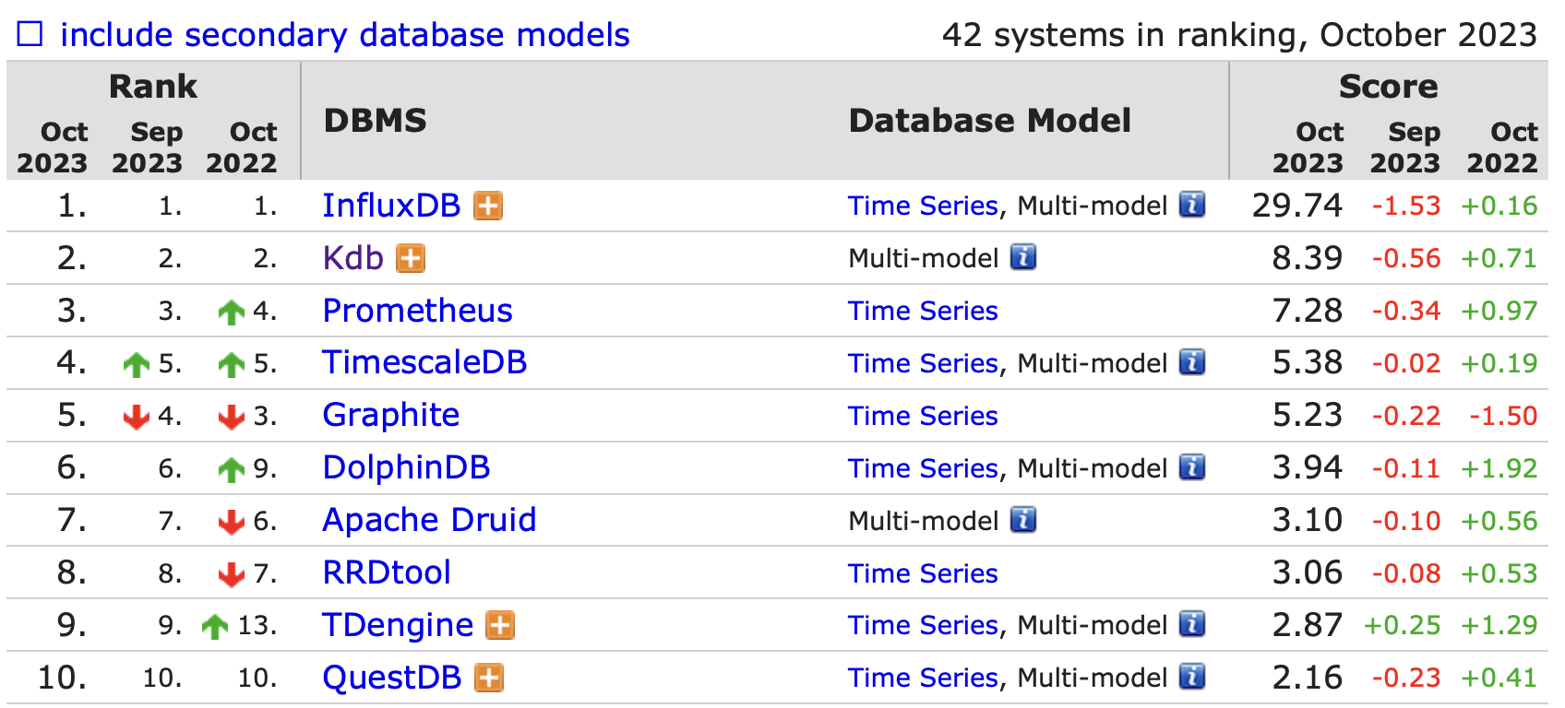
DB-Engines Ranking of Time Series DBMS
DB-Engines Ranking of Time Series DBMS
https://db-engines.com/en/ranking/time+series+dbms

Slide 6
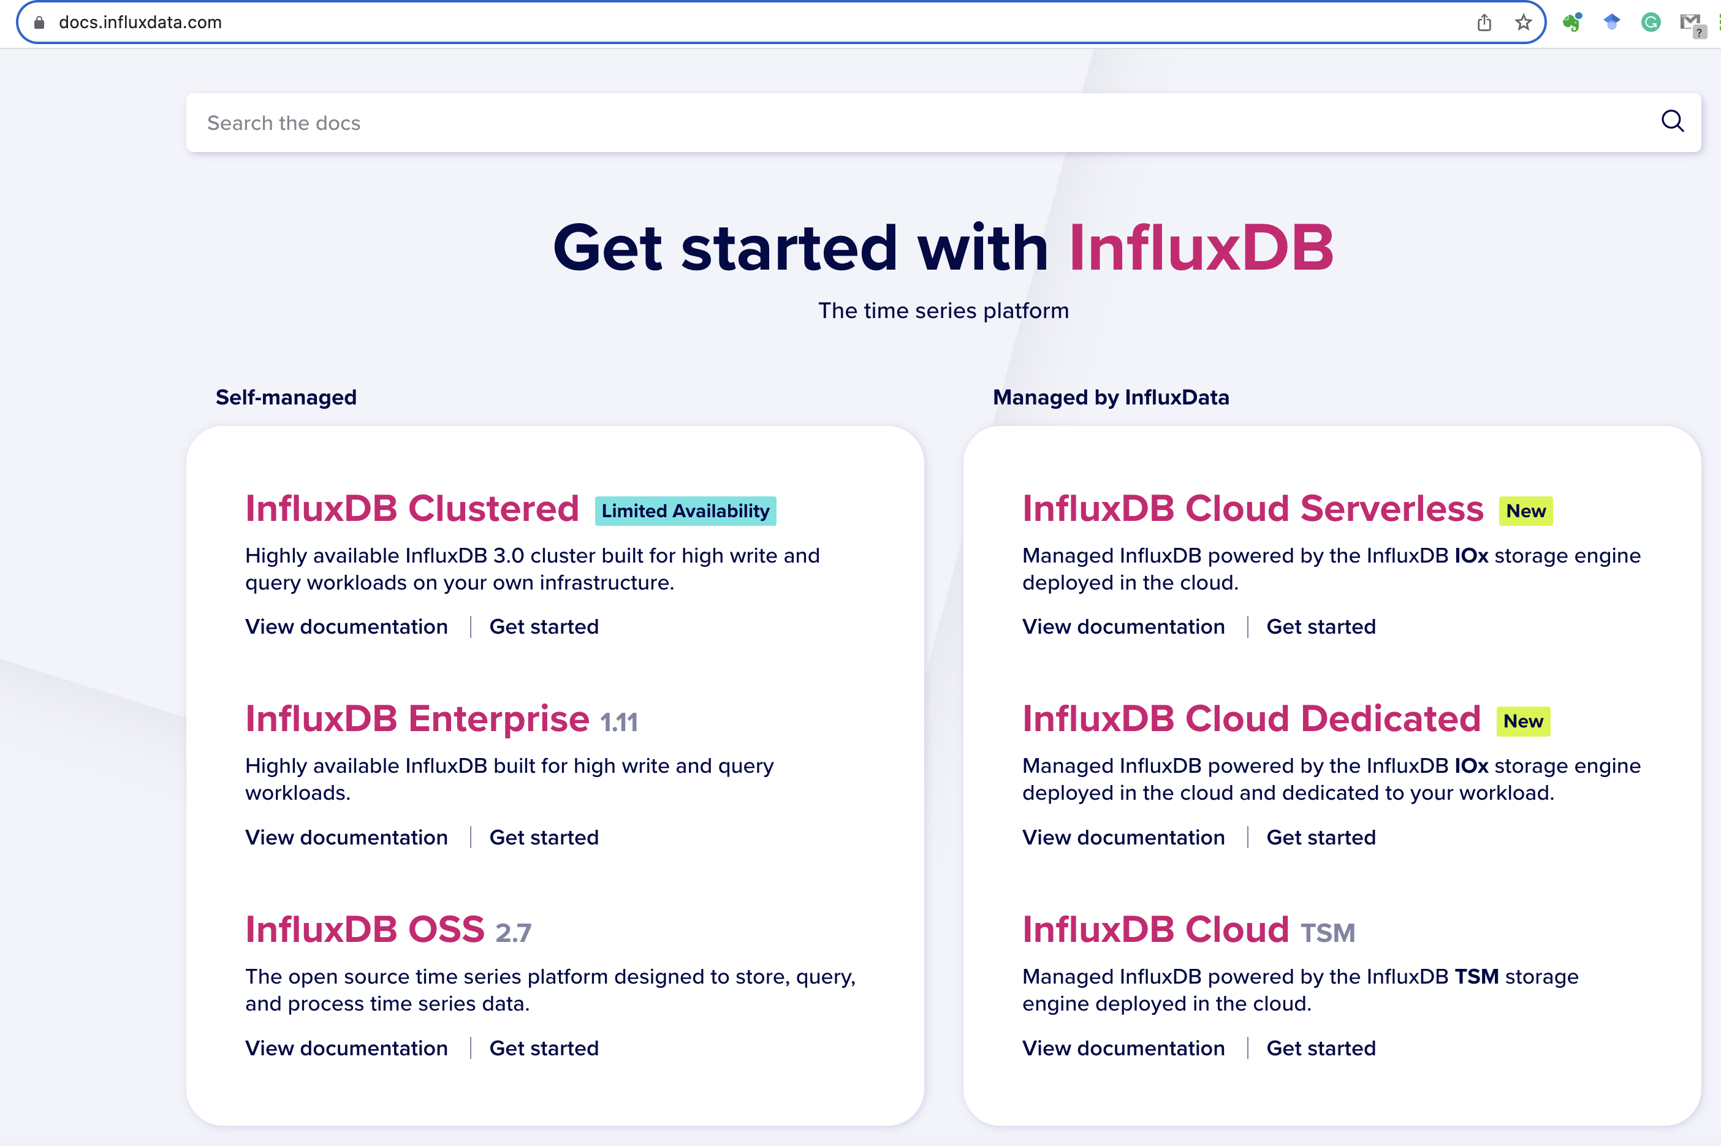
InfluxDB

Slide 7
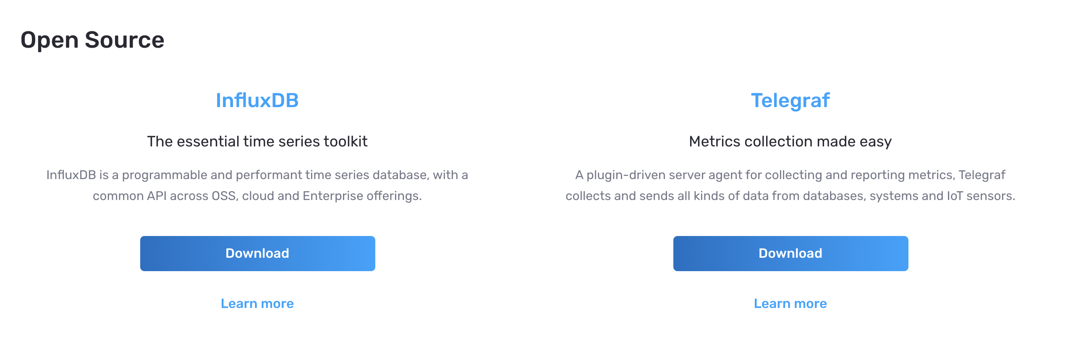
InfluxDB
InfluxDB is the time series platform
Build real-time applications for analytics, IoT and cloud-native services in less time with less code using InfluxDB.
At its heart is a database purpose-built to handle the epic volumes and countless sources of time-stamped data produced by sensors, applications and infrastructure.
If time is relevant to your data, you need a time series database.

Slide 8
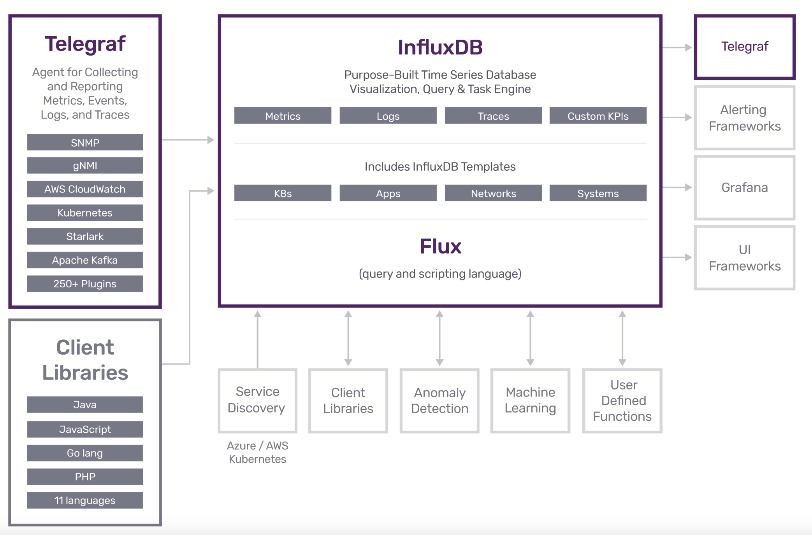
InfluxDB & Telegraf

Slide 9
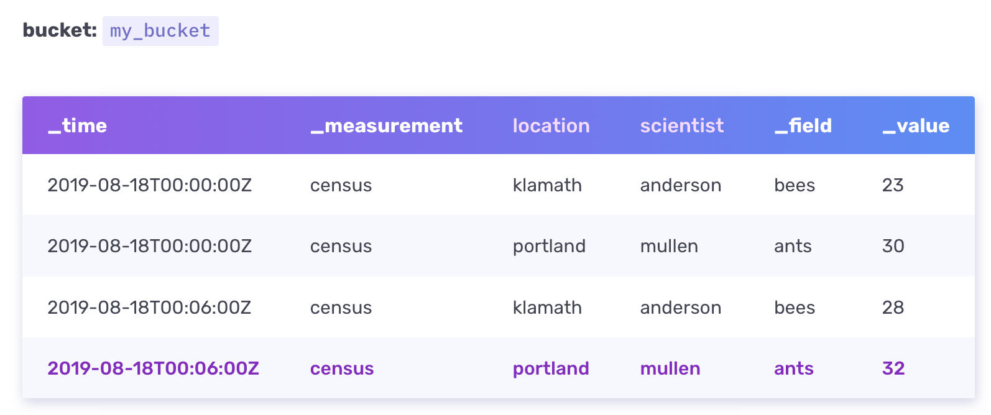
InfluxDB key concepts
InfluxDB data elements
InfluxDB structures data using elements such as timestamps, field keys, field values, tags, etc.
The sample data below is used to illustrate data elements concepts
timestamps
measurement
Tag value
Tag value
Field key
Filed value

Slide 10
InfluxDB key concepts
Timestamp
All data stored in InfluxDB has a _time column that stores timestamps.
On disk, timestamps are stored in epoch nanosecond format. InfluxDB formats timestamps show the date and time in RFC3339 UTC associated with data.
Timestamp precision is important when you write data.
Measurement
The _measurement column shows the name of the measurement census.
A measurement acts as a container for tags, fields, and timestamps.
Use a measurement name that describes your data.
The name census tells us that the field values record the number of bees and ants.

Slide 11
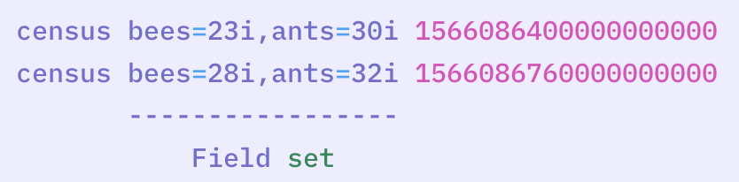
InfluxDB key concepts
Fields
A field includes a field key stored in the _field column and a field value stored in the _value column.
Field key
A field key is a string that represents the name of the field.
Field value
A field value represents the value of an associated field.
Field values can be strings, floats, integers, or booleans.
Field set
A field set is a collection of field key-value pairs associated with a timestamp. The sample data includes the following field sets:

Slide 12
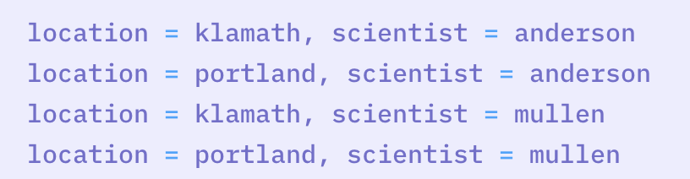
InfluxDB key concepts
Tags
Tags include tag keys and tag values that are stored as strings and metadata.
Tag key
The tag keys in the sample data are location and scientist.
Tag value
The tag key location has two tag values: klamath and portland. The tag key scientist also has two tag values: anderson and mullen.
Tag set
The collection of tag key-value pairs make up a tag set. The sample data includes the following four tag sets:

Slide 13
InfluxDB key concepts
Fields aren’t indexed:
Fields are required in InfluxDB data and are not indexed.
Queries that filter field values must scan all field values to match query conditions.
As a result, queries on tags > are more performant than queries on fields.
Store commonly queried metadata in tags.
Tags are indexed:
Tags are optional.
You don’t need tags in your data structure, but it’s typically a good idea to include tags.
Because tags are indexed, queries on tags are faster than queries on fields.
This makes tags ideal for storing commonly-queried metadata.

Slide 14
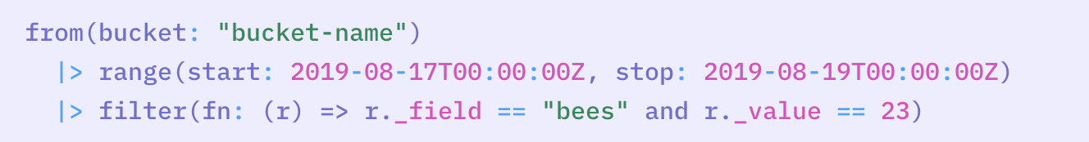
InfluxDB key concepts
Why your schema matters
If most of your queries focus on values in the fields, for example, a query to find when 23 bees were counted:
InfluxDB scans every field value in the dataset for bees before the query returns a response.

Slide 15
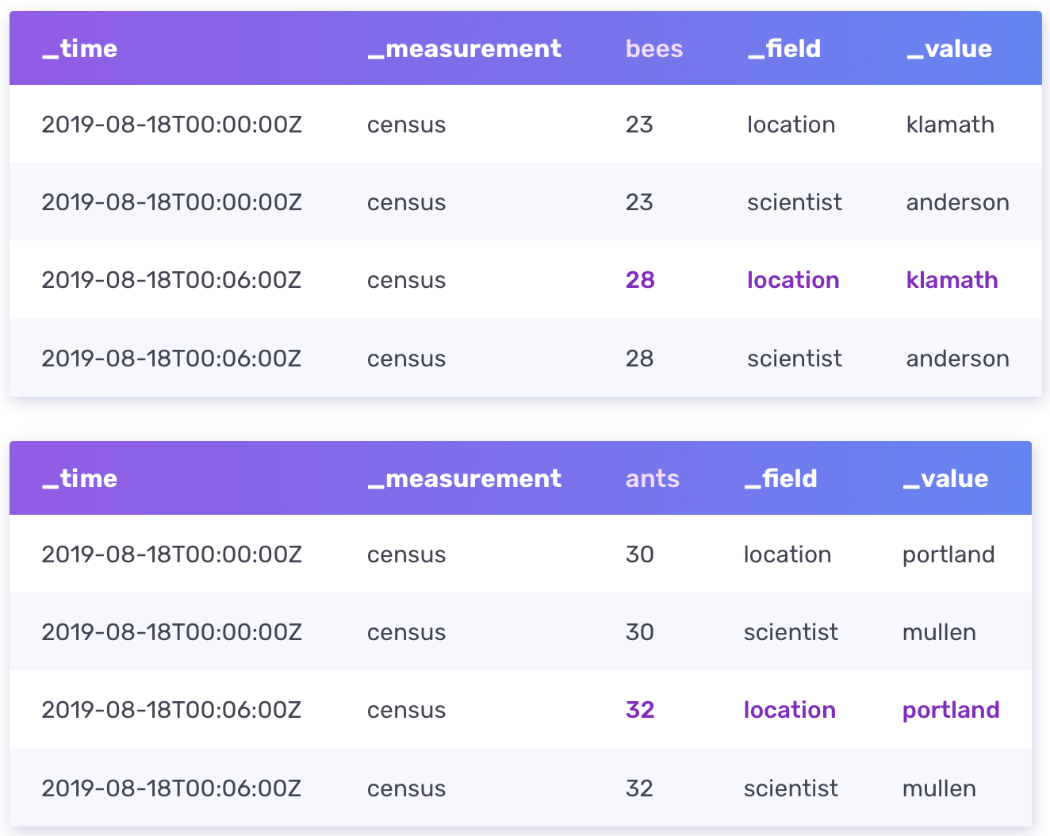
InfluxDB key concepts
Why your schema matters
If our sample census data grew to millions of rows, to optimize your query, you could rearrange your schema so the fields (bees and ants) becomes tags and the tags (location and scientist) become fields:

Slide 16
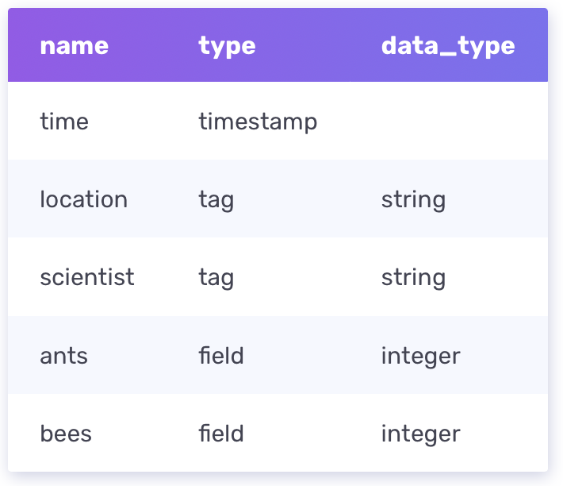
InfluxDB key concepts
Bucket schema
In InfluxDB Cloud, a bucket with the explicit schema-type requires an explicit schema for each measurement. Measurements contain tags, fields, and timestamps. An explicit schema constrains the shape of data that can be written to that measurement.
The following schema constrains census data:

Slide 17
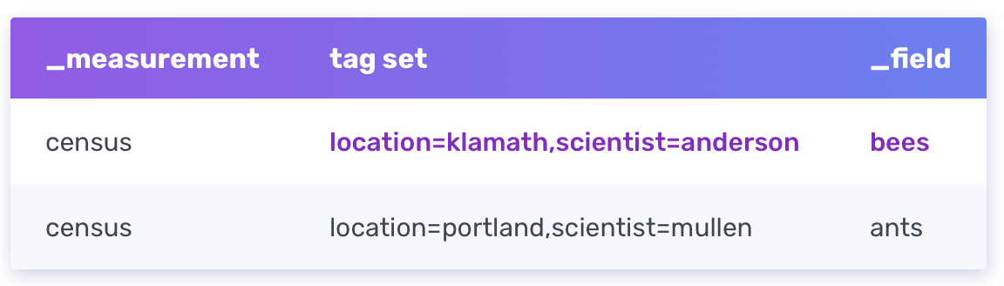
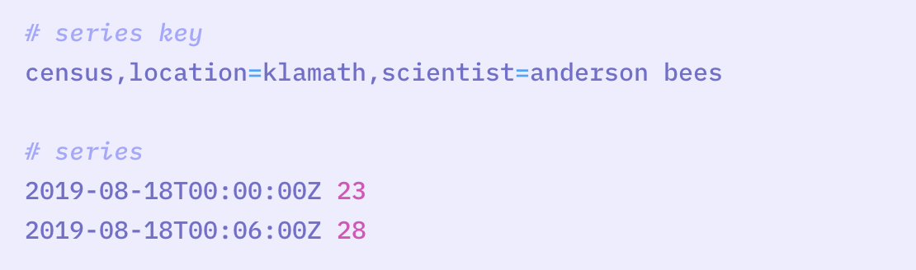
InfluxDB key concepts
Series
A series key is a collection of points that share a measurement, tag set, and field key. For example, the sample data includes two unique series keys:
A series includes timestamps and field values for a given series key. From the sample data, here’s a series key and the corresponding series:

Slide 18
InfluxDB key concepts
Point
A point includes the series key, a field value, and a timestamp. For example, a single point from the sample data looks like this:
Bucket
All InfluxDB data is stored in a bucket. A bucket combines the concept of a database and a retention period (the duration of time that each data point persists). A bucket belongs to an organization.
Organization
An InfluxDB organization is a workspace for a group of users. All dashboards, tasks, buckets, and users belong to an organization.

Slide 19
InfluxDB design principle
InfluxDB implements optimal design principles for time series data.
Some of these design principles may have associated tradeoffs in performance.
Time-ordered data
To improve performance, data is written in time-ascending order.
Strict update and delete permissions
To increase query and write performance, InfluxDB tightly restricts update and delete permissions.
Time series data is predominantly new data that is never updated.
Deletes generally only affect data that isn’t being written to, and contentious updates never occur.

Slide 20
InfluxDB design principle
InfluxDB implements optimal design principles for time series data.
Some of these design principles may have associated tradeoffs in performance.
Handle read and write queries first
InfluxDB prioritizes read and write requests over strong consistency.
InfluxDB returns results when a query is executed.
Any transactions that affect the queried data are processed subsequently to ensure that data is eventually consistent.
Therefore, if the ingest rate is high (multiple writes per ms), query results may not include the most recent data.
Schemaless design
InfluxDB uses a schemaless design to better manage discontinuous data.
Time series data are often ephemeral, meaning the data appears for a few hours and then goes away. For example, a new host that gets started and reports for a while and then gets shut down.

Slide 21
InfluxDB design principle
InfluxDB implements optimal design principles for time series data.
Some of these design principles may have associated tradeoffs in performance.
Datasets over individual points
Because the data set is more important than an individual point, InfluxDB implements powerful tools to aggregate data and handle large data sets.
Points are differentiated by timestamp and series, so don’t have IDs in the traditional sense.
Duplicate data
To simplify conflict resolution and increase write performance, InfluxDB assumes data sent multiple times is duplicate data. Identical points aren’t stored twice.
If a new field value is submitted for a point, InfluxDB updates the point with the most recent field value. In rare circumstances, data may be overwritten.

Slide 22
InfluxDB storage engine
The InfluxDB storage engine ensures that:
Data is safely written to disk
Queried data is returned complete and correct
Data is accurate (first) and performant (second)
The storage engine includes the following components:
Write Ahead Log (WAL)
Cache
Time-Structed Merge Tree (TSM)
Time Series Index (TSI)

Slide 23
InfluxDB storage engine
Writing data from API to disk
The storage engine handles data from the point an API write request is received through writing data to the physical disk.
Data is written to InfluxDB using line protocol sent via HTTP POST request to the /writeendpoint.
Batches of points are sent to InfluxDB, compressed, and written to a WAL for immediate durability.
Points are also written to an in-memory cache and become immediately queryable.
The in-memory cache is periodically written to disk in the form of TSM files.
As TSM files accumulate, the storage engine combines and compacts accumulated them into higher level TSM files.
While points can be sent individually, for efficiency, most applications send points in batches.
Points in a POST body can be from an arbitrary number of series, measurements, and tag sets.
Points in a batch do not have to be from the same measurement or tagset.

Slide 24
InfluxDB storage engine
Write Ahead Log (WAL)
The Write Ahead Log (WAL) retains InfluxDB data when the storage engine restarts. The WAL ensures data is durable in case of an unexpected failure.
When the storage engine receives a write request, the following steps occur:
The write request is appended to the end of the WAL file.
Data is written to disk using fsync().
The in-memory cache is updated.
When data is successfully written to disk, a response confirms the write request was successful.

Slide 25
InfluxDB storage engine
Cache
The cache is an in-memory copy of data points currently stored in the WAL.
The cache:
Organizes points by key (measurement, tag set, and unique field) Each field is stored in its own time-ordered range.
Stores uncompressed data.
Gets updates from the WAL each time the storage engine restarts. The cache is queried at runtime and merged with the data stored in TSM files.

Slide 26
InfluxDB storage engine
Time-Structured Merge Tree (TSM)
To efficiently compact and store data, the storage engine groups field values by series key, and then orders those field values by time.
The storage engine uses a Time-Structured Merge Tree (TSM) data format.
TSM files store compressed series data in a columnar format.
To improve efficiency, the storage engine only stores differences (or deltas) between values in a series.
Column-oriented storage lets the engine read by series key and omit extraneous data.

Slide 27
InfluxDB storage engine
Time Series Index (TSI)
As data cardinality (the number of series) grows, queries read more series keys and become slower.
The Time Series Index ensures queries remain fast as data cardinality grows.
The TSI stores series keys grouped by measurement, tag, and field. This allows the database to answer two questions well:
What measurements, tags, fields exist? (This happens in meta queries.)
Given a measurement, tags, and fields, what series keys exist?

Slide 28
InfluxDB file system layout
InfluxDB file structure
Engine path
Directory path to the storage engine, where InfluxDB stores time series data, includes the following directories:
data: stores Time-Structured Merge Tree (TSM) files
wal: stores Write Ahead Log (WAL) files.
Bolt path
File path to the Boltdb database, a file-based key-value store for non-time series data, such as InfluxDB users, dashboards, tasks, etc.
Configs path
File path to influx CLI connection configurations (configs).
InfluxDB configuration files
Some operating systems and package managers store a default InfluxDB (influxd) configuration file on disk.

Slide 29
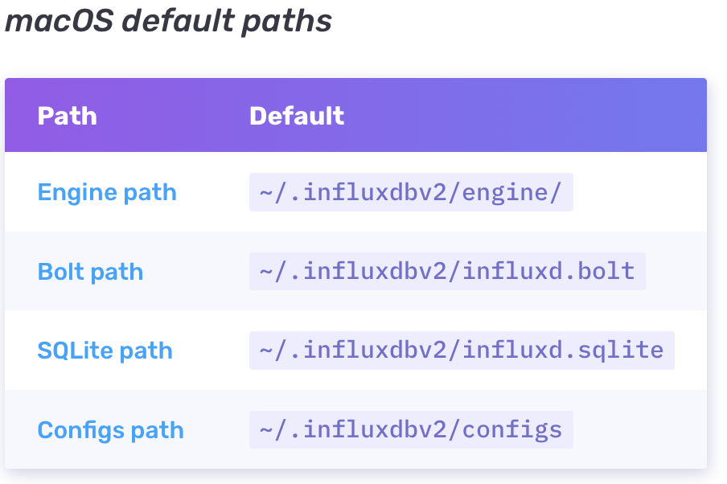
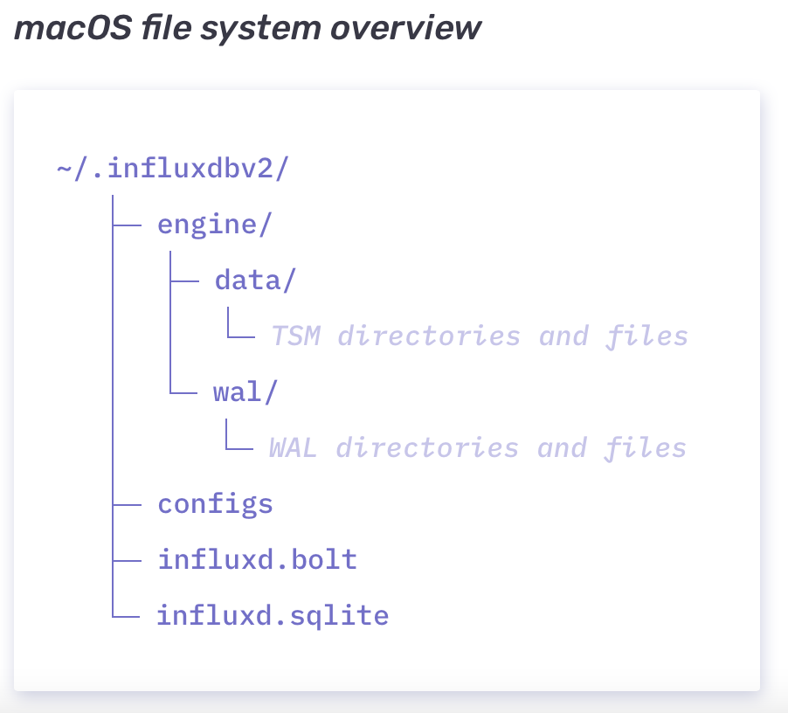
InfluxDB file system layout
File System Layout

Slide 30
InfluxDB shards and shard groups
Shards
A shard contains encoded and compressed time series data for a given time range defined by the shard group duration.
All points in a series within the specified shard group duration are stored in the same shard.
A single shard contains multiple series, one or more TSM files on disk, and belongs to a shard group.
Shard groups
A shard group belongs to an InfluxDB bucket and contains time series data for a specific time range defined by the shard group duration.
In InfluxDB OSS, a shard group typically contains only a single shard.
In an InfluxDB Enterprise 1.x cluster, shard groups contain multiple shards distributed across multiple data nodes.

Slide 31
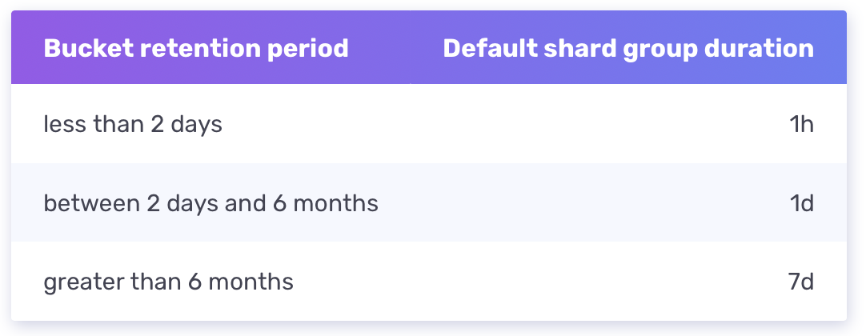
InfluxDB shards and shard groups
Shard group duration
The shard group duration specifies the time range for each shard group and determines how often to create a new shard group. By default, InfluxDB sets the shard group duration according to the retention period of the bucket:

Slide 32
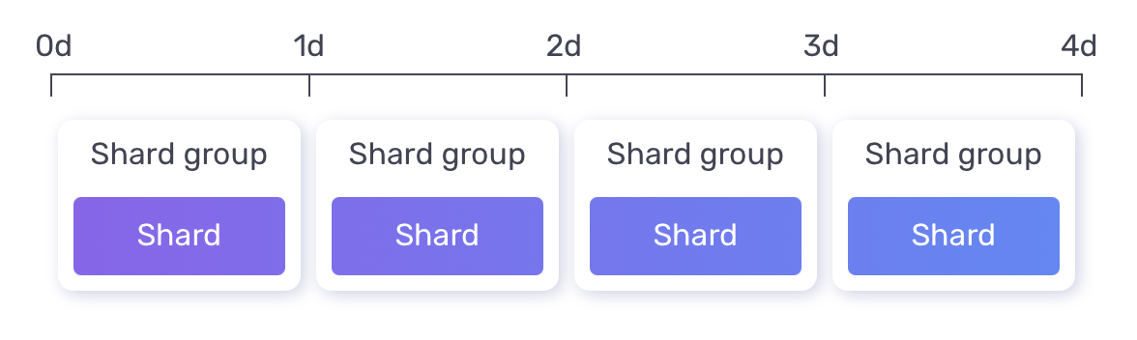
InfluxDB shards and shard groups
Shard group diagram
The following diagram represents a bucket with a 4d retention period and a 1d shard group duration:

Slide 33
Shard life-cycle
Shard precreation
The InfluxDB shard precreation service pre-creates shards with future start and end times for each shard group based on the shard group duration.
The precreator service does not pre-create shards for past time ranges.
When backfilling historical data, InfluxDB creates shards for past time ranges as needed, resulting in temporarily lower write throughput.
Shard writes
InfluxDB writes time series data to un-compacted or “hot” shards. When a shard is no longer actively written to, InfluxDB compacts shard data, resulting in a “cold” shard.
Typically, InfluxDB writes data to the most recent shard group, but when backfilling historical data, InfluxDB writes to older shards that must first be un-compacted. When the backfill is complete, InfluxDB re-compacts the older shards.

Slide 34
Shard life-cycle
Shard compaction
InfluxDB compacts shards at regular intervals to compress time series data and optimize disk usage.
InfluxDB uses the following four compaction levels:
Level 1 (L1): InfluxDB flushes all newly written data held in an in-memory cache to disk.
Level 2 (L2): InfluxDB compacts up to eight L1-compacted files into one or more L2 files by combining multiple blocks containing the same series into fewer blocks in one or more new files.
Level 3 (L3): InfluxDB iterates over L2-compacted file blocks (over a certain size) and combines multiple blocks containing the same series into one block in a new file.
Level 4 (L4): Full compaction—InfluxDB iterates over L3-compacted file blocks and combines multiple blocks containing the same series into one block in a new file.

Slide 35
Shard life-cycle
Shard deletion
The InfluxDB retention enforcement service routinely checks for shard groups older than their bucket’s retention period.
Once the start time of a shard group is beyond the bucket’s retention period, InfluxDB deletes the shard group and associated shards and TSM files.
In buckets with an infinite retention period, shards remain on disk indefinitely.

Slide 36
Run InfluxDB
Install InfluxDB v2.1
Use Homebrew
We recommend using Homebrew to install InfluxDB v2.1 on macOS:
$ brew update
$ brew install influxdb
Install Telegraf
$ brew update
$ brew install telegraf
Start InfluxDB
$influxd
Set up InfluxDB through the UI
With InfluxDB running, visit localhost:8086.
Click Get Started
Set up your initial user
Enter a Username for your initial user.
Enter a Password and Confirm Password for your user.
Enter your initial Organization Name.
Enter your initial Bucket Name.
Click Continue.

Slide 37
Run InfluxDB
Configure your token as an environment variable
$ export INFLUX_TOKEN=YourAuthenticationToken
Start the Telegraf service
$ telegraf -config http://localhost:8086/api/v2/telegrafs/0xoX00oOx0xoX00o

Slide 38
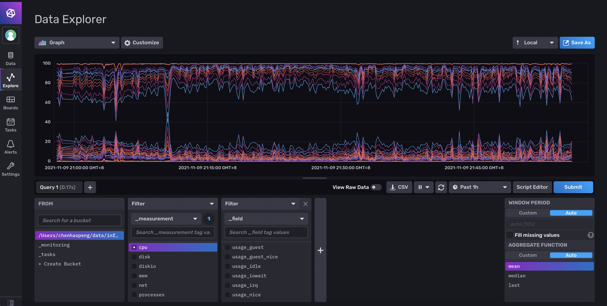
InfluxDB Data Explorer

Slide 39
Access InfluxDB via Java
influxdb-client-java
https://github.com/influxdata/influxdb-client-java
pom.xml
<dependency> <groupId>com.influxdb</groupId> <artifactId>influxdb-client-java</artifactId> <version>6.10.0</version> </dependency>

Slide 40
Access InfluxDB via Java
Mem.java
@Measurement(name = "mem") public class Mem { @Column(tag = true) String host; @Column Double used_percent; @Column(timestamp = true) Instant time; }

Slide 41
Access InfluxDB via Java
InfluxDBSample.java – Create Bucket
public class InfluxDBSample { private static char[] token = "5iyC7-_sDQULhy7gYYRQhgPDInv7aXlI0TFPMQhd51l17A9jDdz2iOhGa91xRsbPQMQz9zTe6yK9Ls49fHJKLQ==".toCharArray(); public static void main(final String[] args) { InfluxDBClient influxDBClient = InfluxDBClientFactory.create("http://localhost:8086", token); // // Create bucket "iot_bucket" with data retention set to 3,600 seconds // var retention = new BucketRetentionRules(); retention.setEverySeconds(3600); Bucket bucket = influxDBClient.getBucketsApi().createBucket("iot-bucket", retention, "9f35c0d435b51094");

Slide 42
Access InfluxDB via Java
InfluxDBSample.java – Create Bucket
// // Create access token to "iot_bucket" // PermissionResource resource = new PermissionResource(); resource.setId(bucket.getId()); resource.setOrgID("9f35c0d435b51094"); resource.setType(PermissionResource.TYPE_BUCKETS); // Read permission Permission read = new Permission(); read.setResource(resource); read.setAction(Permission.ActionEnum.READ);

Slide 43
Access InfluxDB via Java
InfluxDBSample.java – Create Bucket
// Write permission Permission write = new Permission(); write.setResource(resource); write.setAction(Permission.ActionEnum.WRITE); Authorization authorization = influxDBClient.getAuthorizationsApi() .createAuthorization("9f35c0d435b51094", Arrays.asList(read, write)); // // Created token that can be use for writes to "iot_bucket" // String token = authorization.getToken(); System.out.println("Token: " + token); influxDBClient.close(); } }

Slide 44
Access InfluxDB via Java
InfluxDB2Example.java – Write/Read Bucket
public class InfluxDB2Example { public static void main(final String[] args) { // You can generate a Token from the "Tokens Tab" in the UI String token = "5iyC7-_sDQULhy7gYYRQhgPDInv7aXlI0TFPMQhd51l17A9jDdz2iOhGa91xRsbPQMQz9zTe6yK9Ls49fHJKLQ=="; String bucket = "iot-bucket"; String org = "SJTU"; InfluxDBClient client = InfluxDBClientFactory.create("http://localhost:8086", token.toCharArray()); String data = "mem,host=host1 used_percent=23.43234543"; try (WriteApi writeApi = client.getWriteApi()) { writeApi.writeRecord(bucket, org, WritePrecision.NS, data); }

Slide 45
Access InfluxDB via Java
InfluxDB2Example.java – Write/Read Bucket
Point point = Point .measurement("mem") .addTag("host", "host1") .addField("used_percent", 23.43234543) .time(Instant.now(), WritePrecision.NS); try (WriteApi writeApi = client.getWriteApi()) { writeApi.writePoint(bucket, org, point); } Mem mem = new Mem(); mem.host = "host1"; mem.used_percent = 23.43234543; mem.time = Instant.now();

Slide 46
Access InfluxDB via Java
InfluxDB2Example.java – Write/Read Bucket
try (WriteApi writeApi = client.getWriteApi()) { writeApi.writeMeasurement(bucket, org, WritePrecision.NS, mem); } String query = String.format("from(bucket: \"%s\") |> range(start: -1h)", bucket); List<FluxTable> tables = client.getQueryApi().query(query, org); Iterator<FluxTable> it = tables.iterator(); while (it.hasNext()) { FluxTable ft = it.next(); List<FluxRecord> records = ft.getRecords(); for ( FluxRecord record: records) { System.out.println(record.getValues()); } } } }

Slide 47
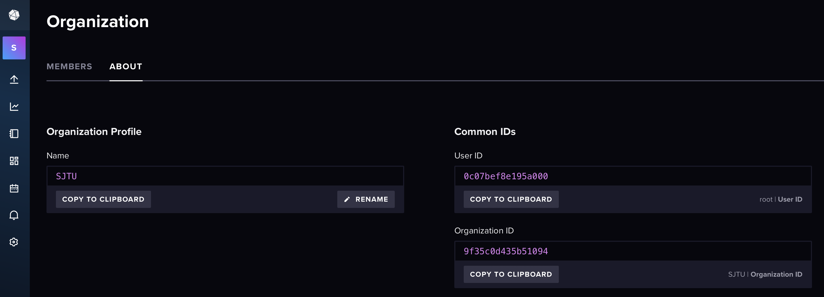
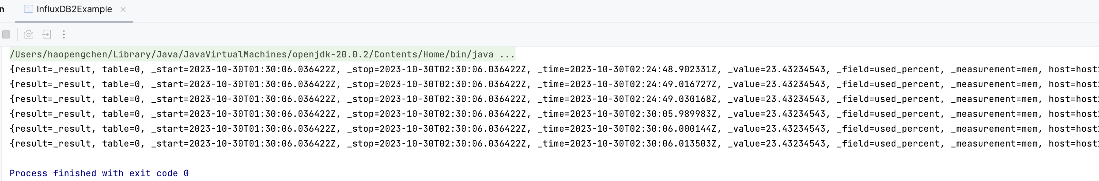
Access InfluxDB via Java

Slide 48
References
时序数据库简介
https://zhuanlan.zhihu.com/p/115567891
Time series database (TSDB) explained
https://www.influxdata.com/time-series-database/
DB-Engines Ranking of Time Series DBMS
https://db-engines.com/en/ranking/time+series+dbms
Why Time Series Matters for Metrics, Real-Time Analytics and Sensor Data
http://get.influxdata.com/rs/972-GDU-533/images/why%20time%20series.pdf
InfluxData Downloads
https://portal.influxdata.com/downloads/
influxdb-client-java
https://github.com/influxdata/influxdb-client-java

Slide 49

Thank You!

